Slide 1
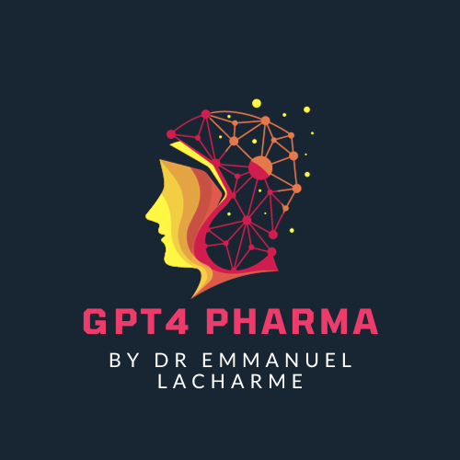
The Future of Life Sciences: Leveraging AI for Breakthroughs
Powered by GPT4 Technology

Slide 2
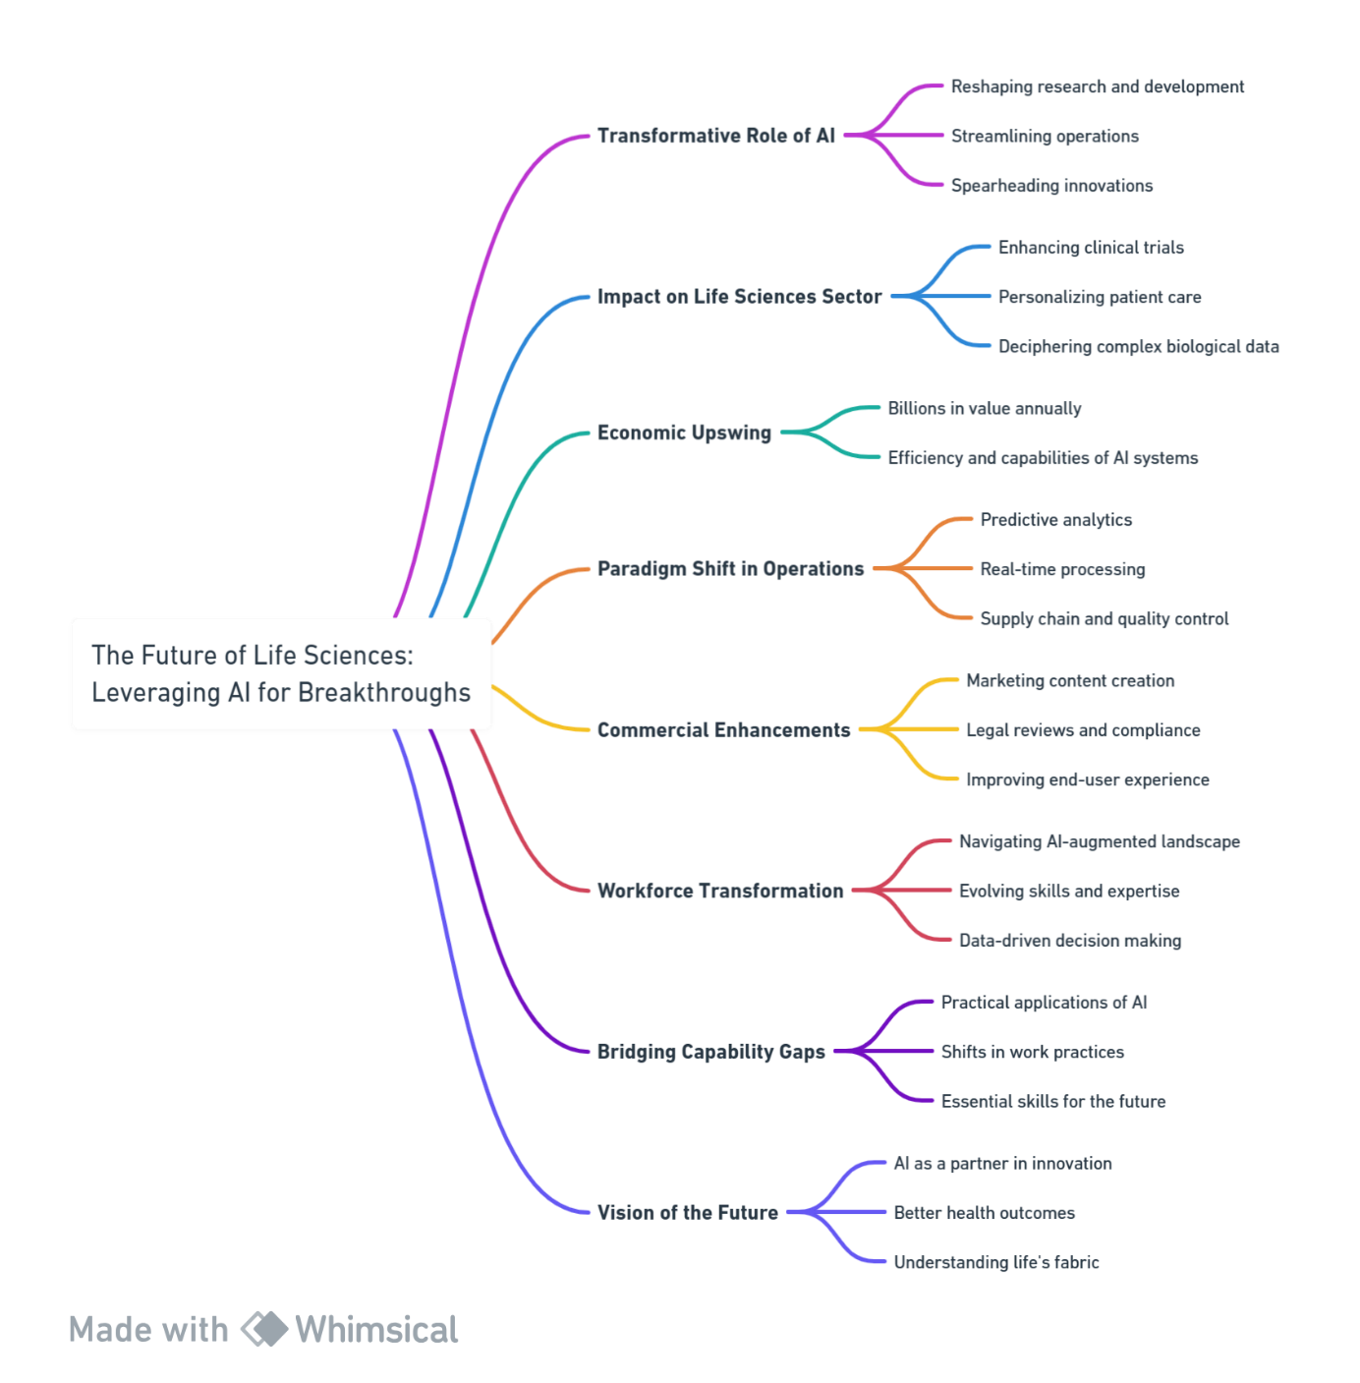
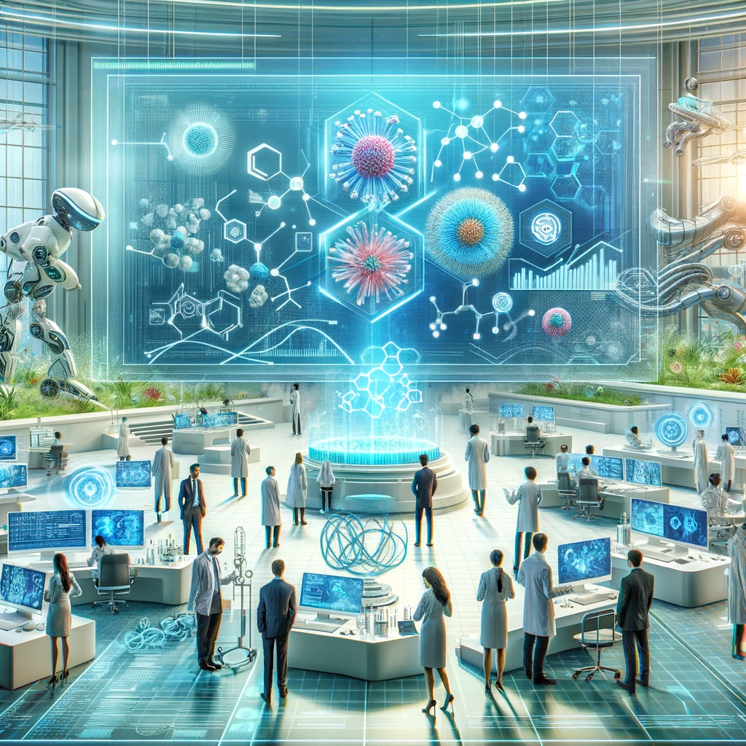
Introduction: Harnessing the Power of AI in the Life Sciences

Slide 3
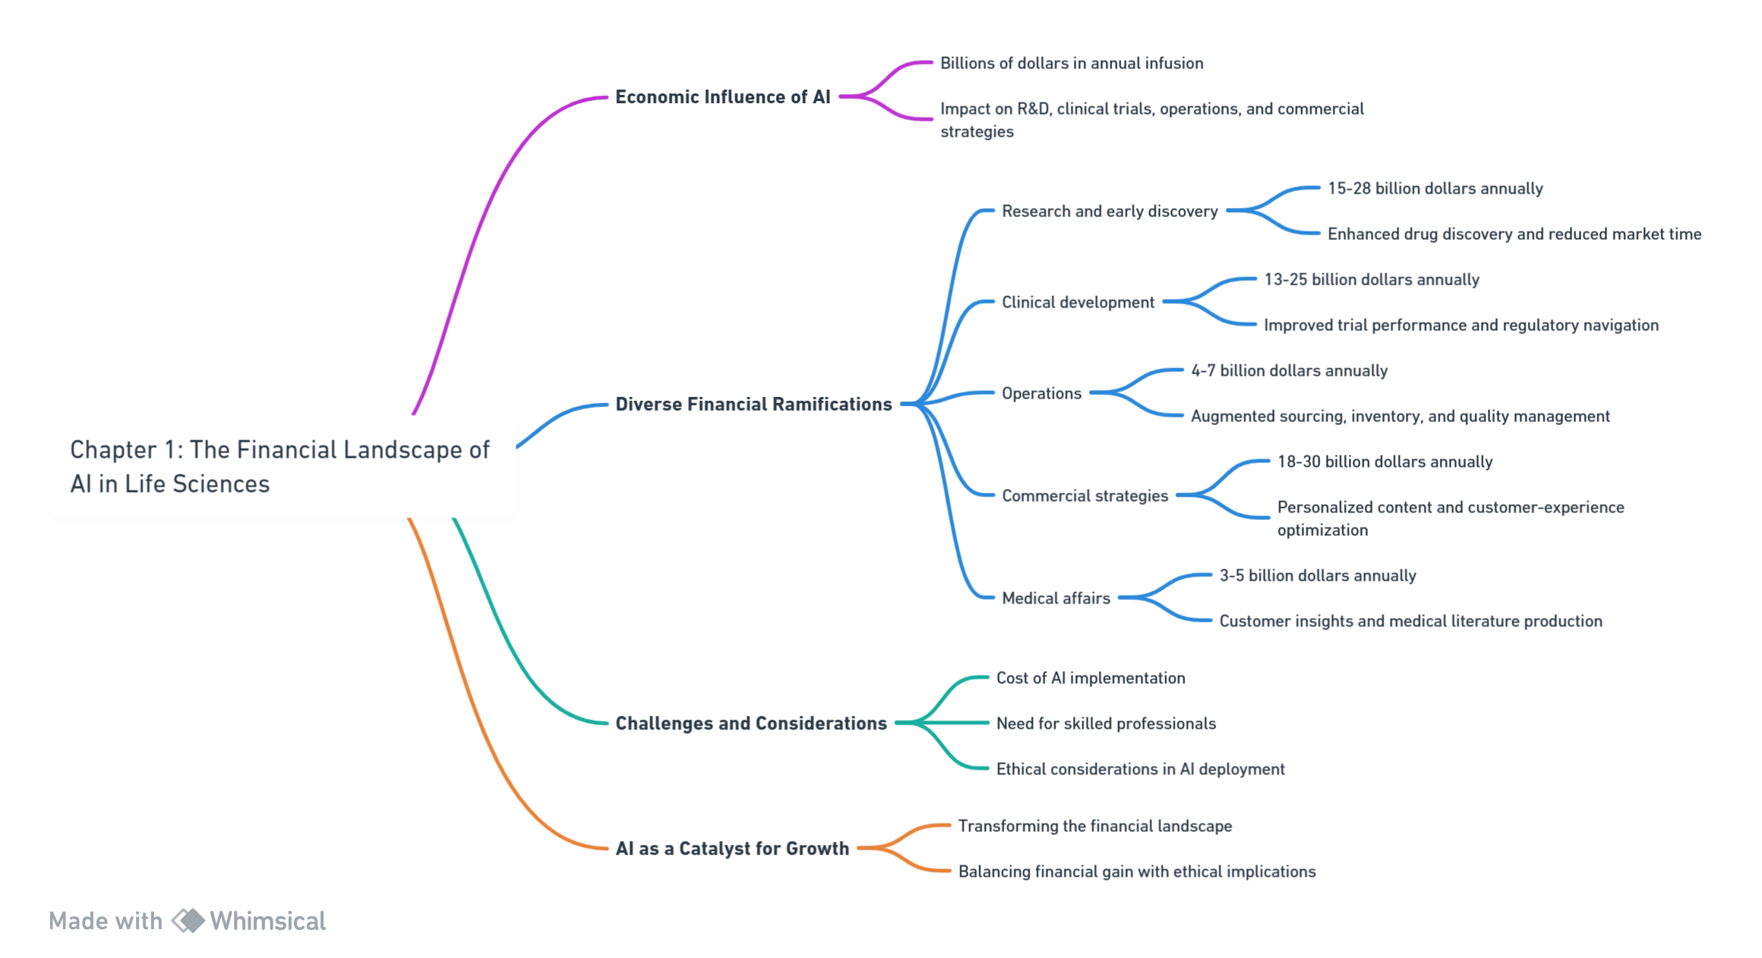
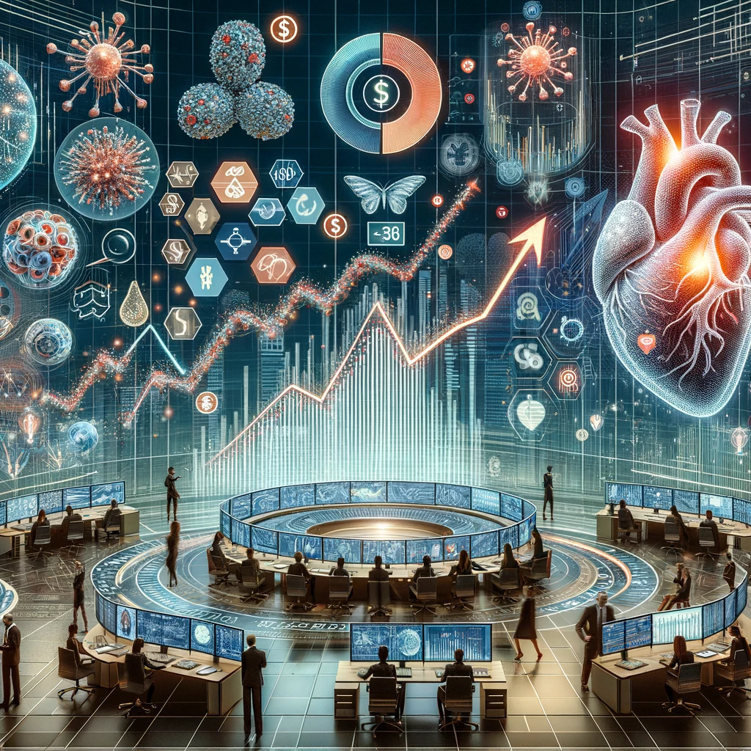
The Financial Landscape of AI in Life Sciences
Reference for financial numbers: Generative AI in the pharmaceutical industry: Moving from hype to reality | McKinsey

Slide 4
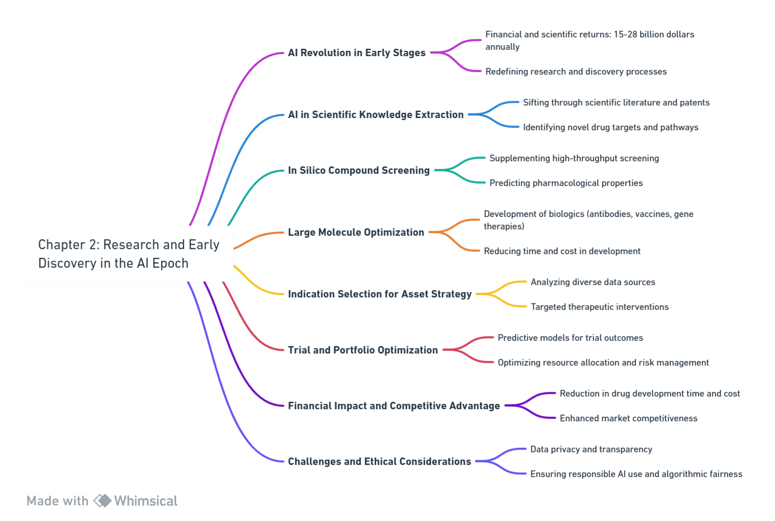
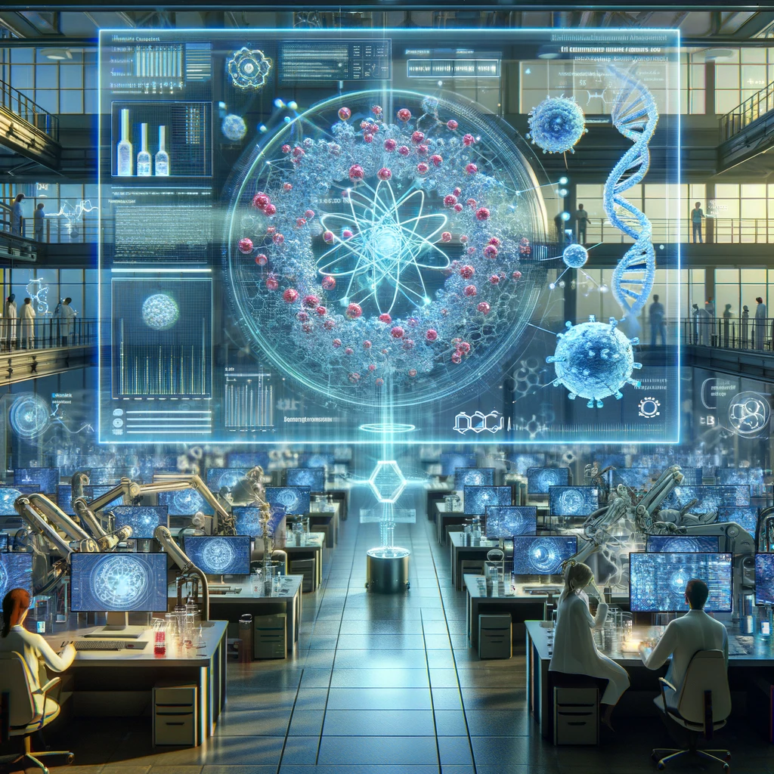
Research and Early Discovery in the AI Epoch

Slide 5
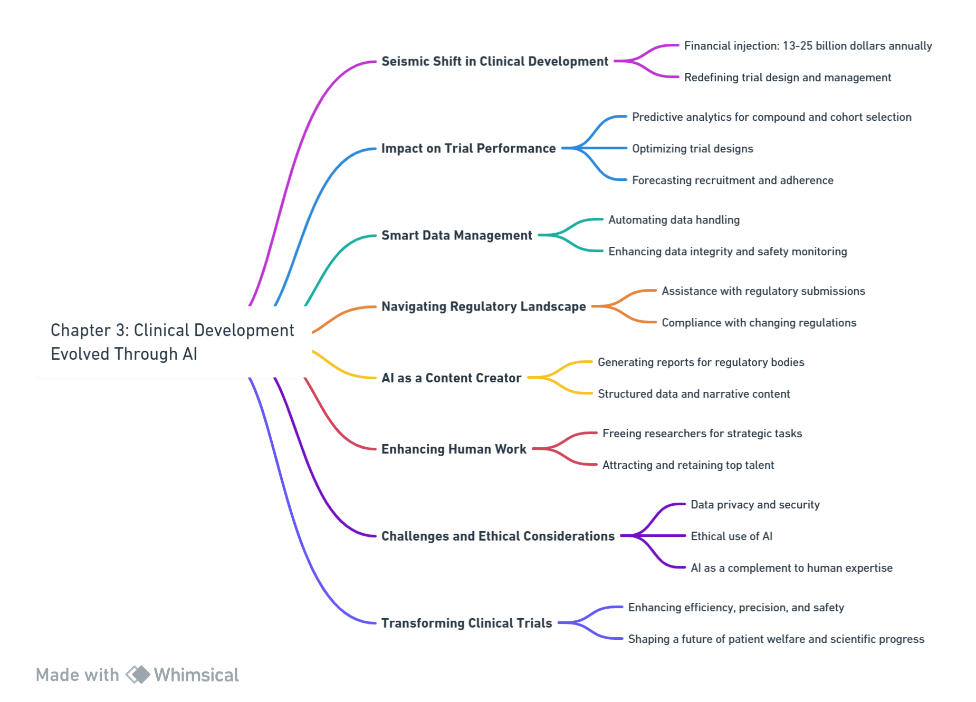
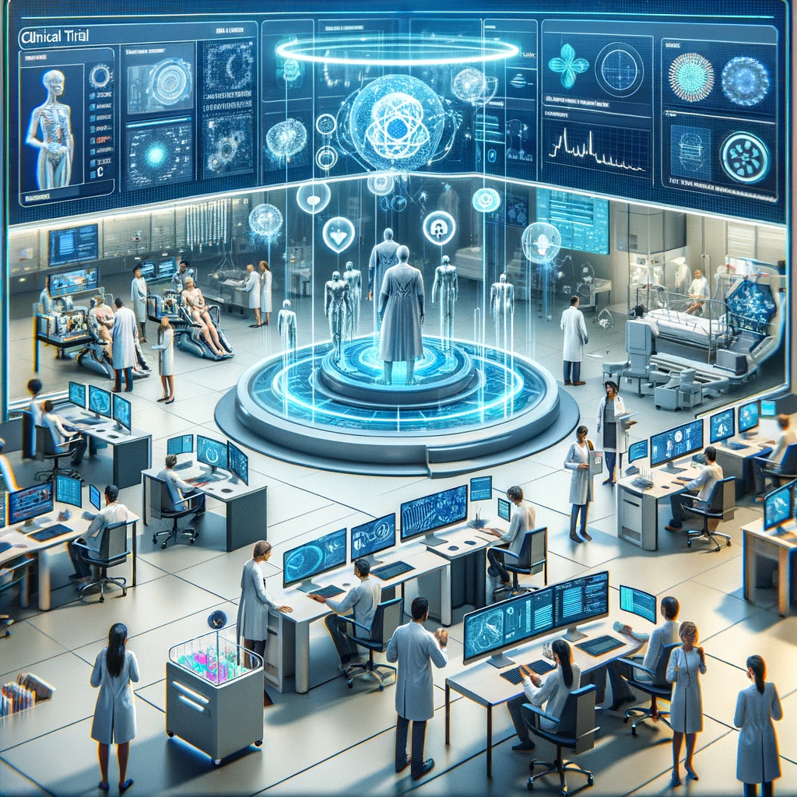
Clinical Development Evolved Through AI

Slide 6
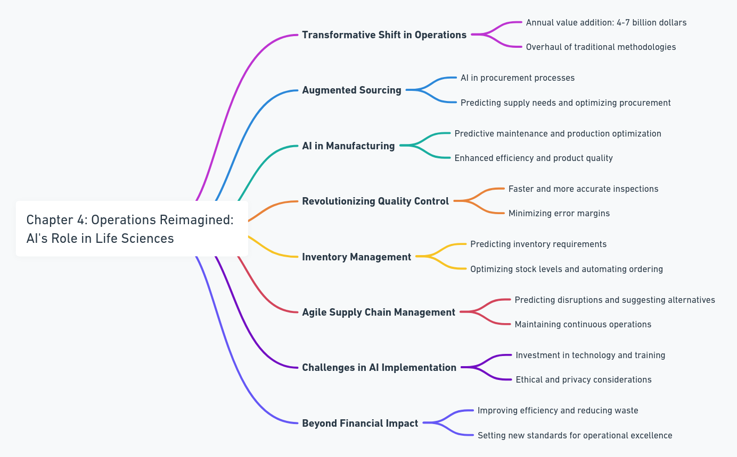
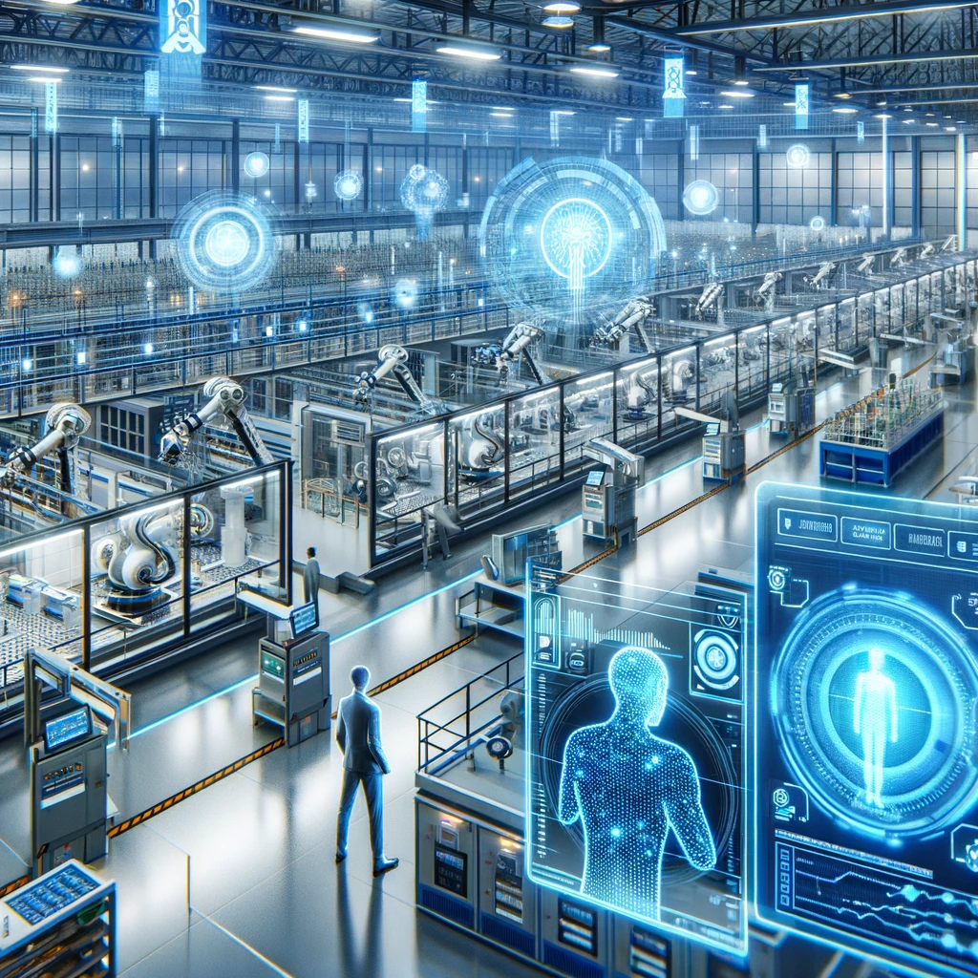
Operations Reimagined: AI's Role in Life Sciences

Slide 7
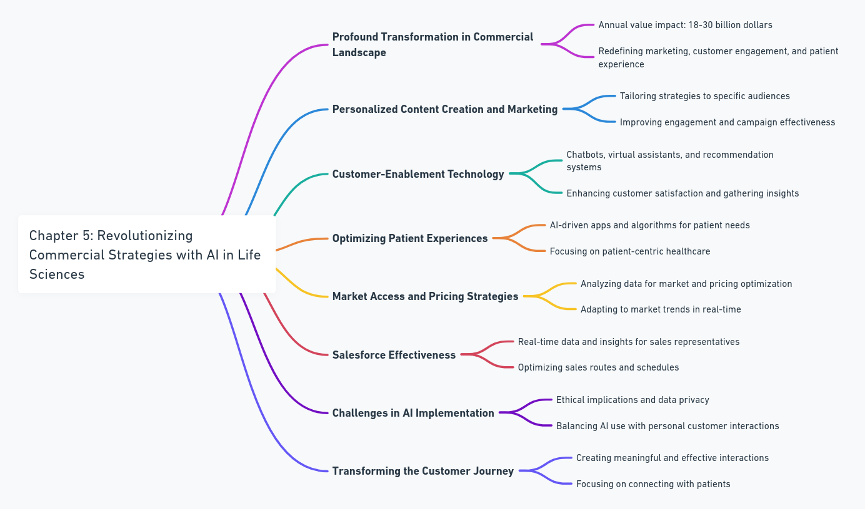
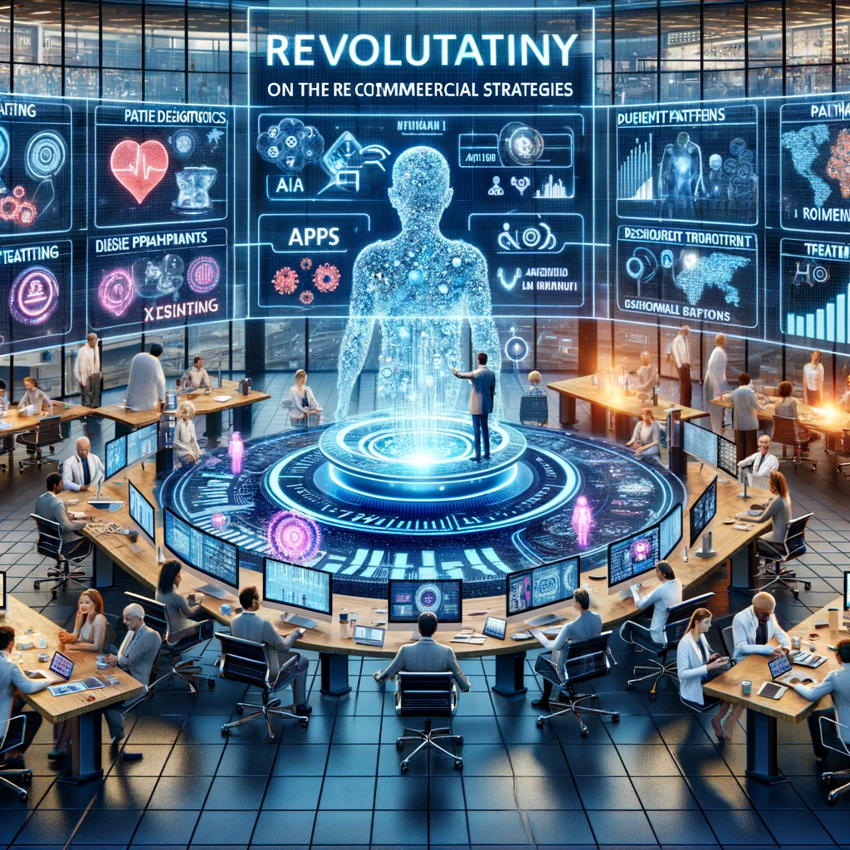
Revolutionizing Commercial Strategies with AI in Life Sciences

Slide 8
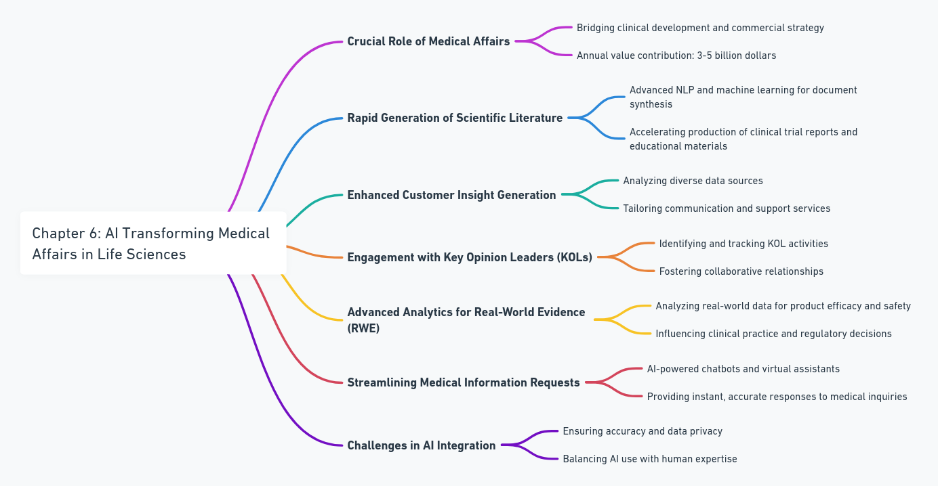
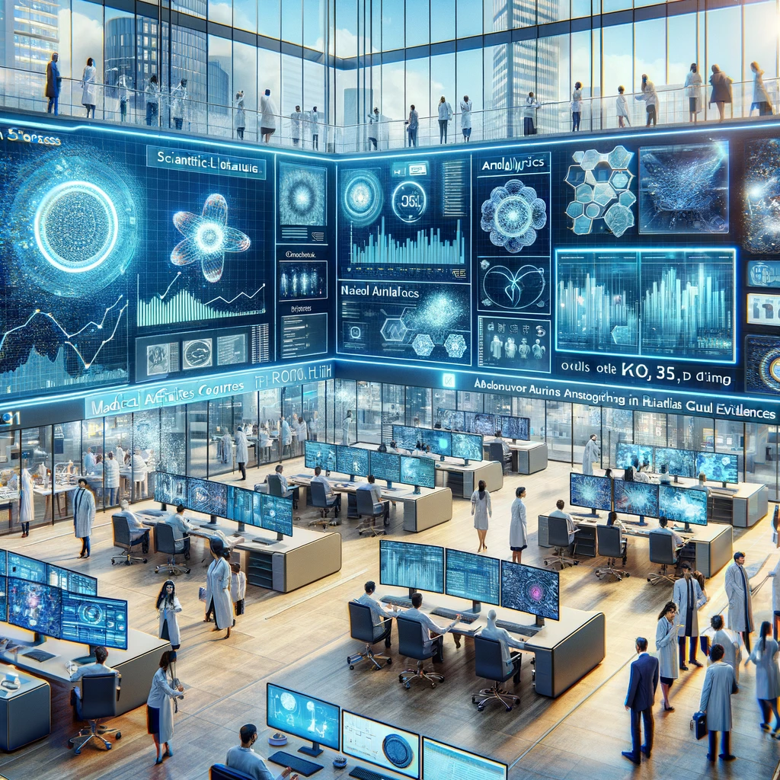
AI Transforming Medical Affairs in Life Sciences

Slide 9
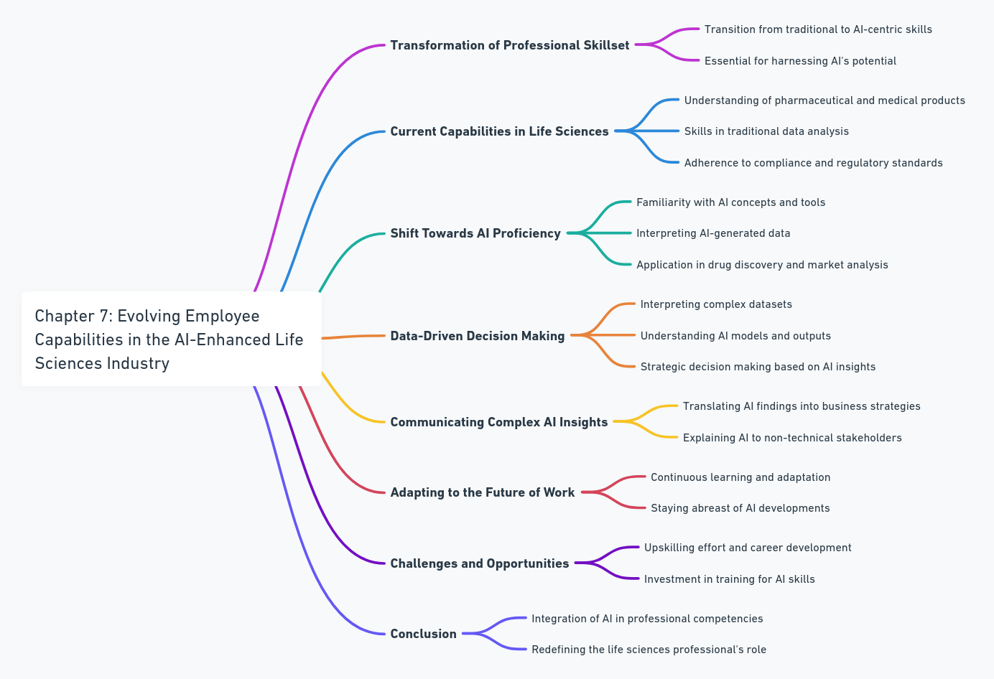
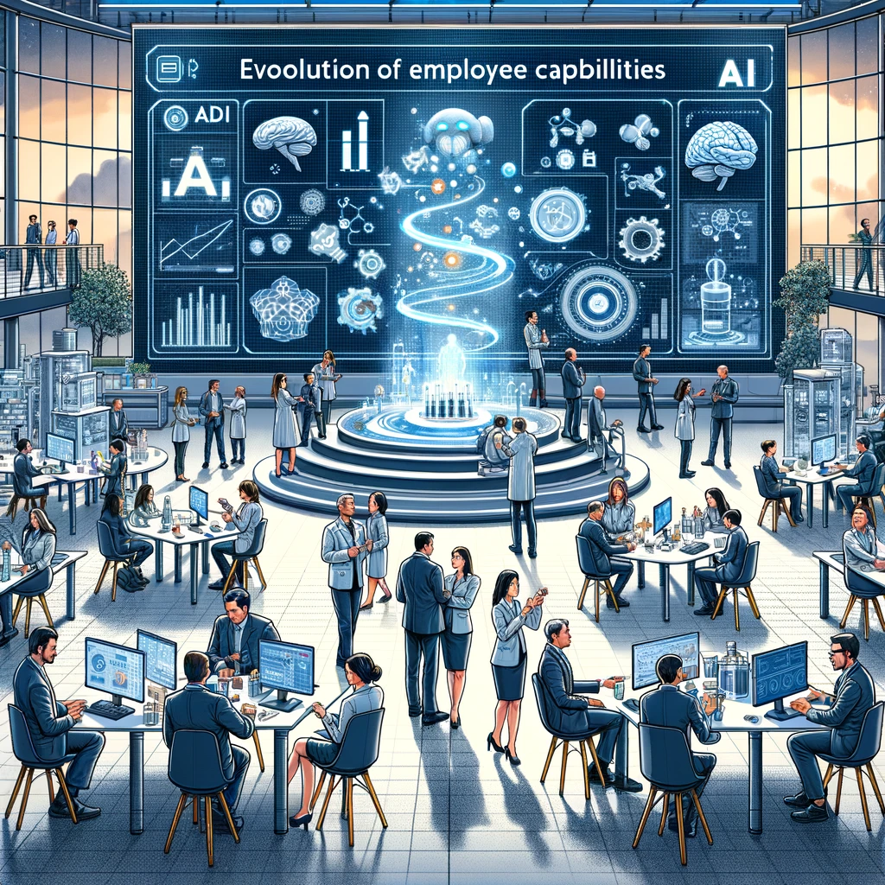
Evolving Employee Capabilities in the AI-Enhanced Life Sciences Industry

Slide 10
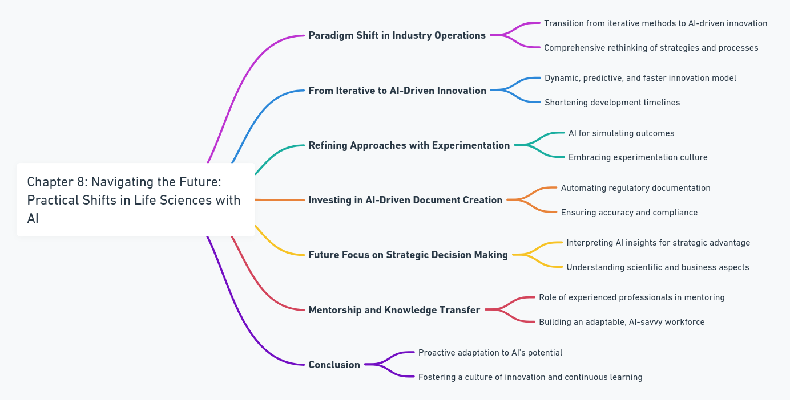
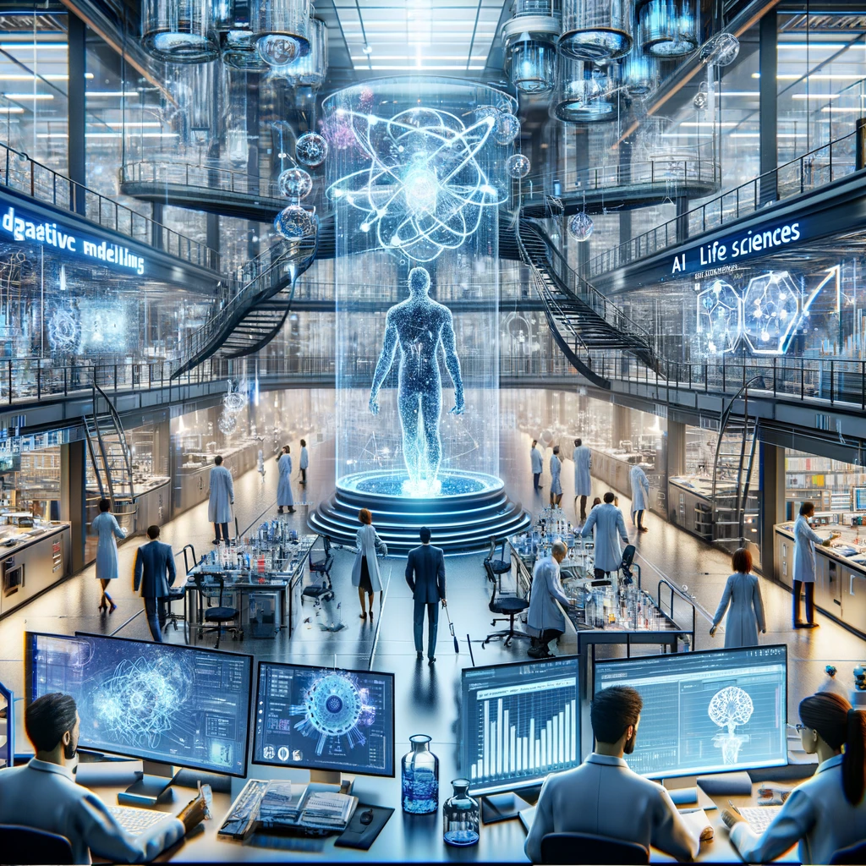
Navigating the Future: Practical Shifts in Life Sciences with AI

Slide 11
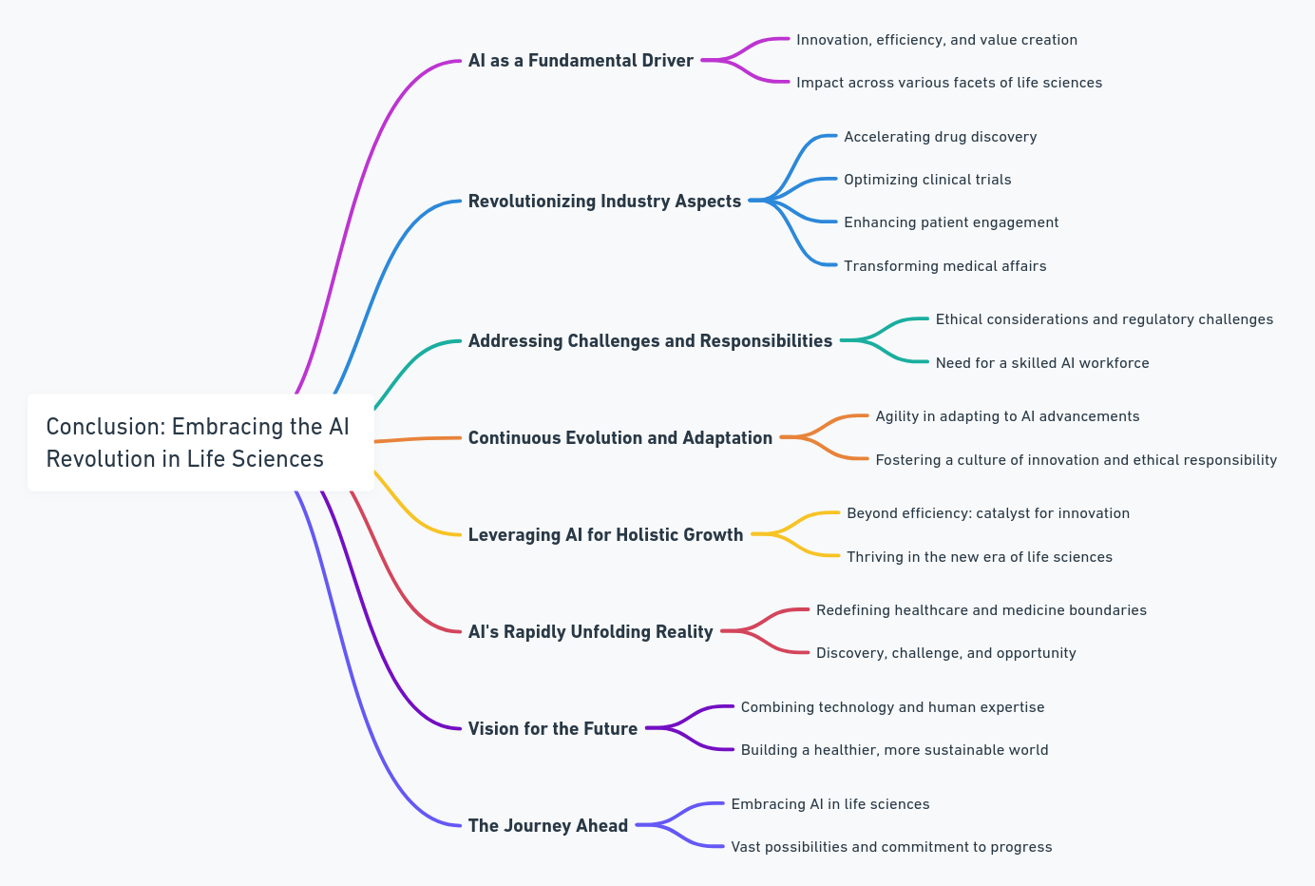
Conclusion: Embracing the AI Revolution in Life Sciences

